Slide 1


WELCOME
Michael VanHook, M. Ed.
MSV Educational Network
Presented to
BRAZ-TESOL Southern Cone
Conference 2019

Slide 2


STUDENTS TEACH
THEIR TEACHER
UNDERSTANDING STUDENTS
WITH LEARNING DISABILIES
Notes:
Hope- It is my sincere hope that our time together will help us to become more effective teachers so that our students can thrive and experience their hopes and dreams.

Slide 3

Today
Notes:
Teachers Transform Lives
THE DIFFICULT ONES- Struggle with Learning Despite Our Best Efforts

Slide 4

This Was Me
Notes:
THIS WAS ME- My Knowledge- I had a lot to learn about students with learning disabilities. What I did not know exceeded what I knew.
Clinical / Academic Knowledge

Slide 5

My Point of View
“Bottom-up” vs. “Top-down” approach
Maybe I could become a better teacher if my students taught me.
Notes:
What Could Students Teach Me- About their personal successes and failures, their hopes and struggles, and their individual learning styles? No one was asking them or listening. Their perspective was considered irrelevant.
POINT OF VIEW- qualitative research study is to analyze and interpret effective educational and instructional practices for students with learning disabilities by gaining insight from the student’s perspective and how these perspectives can impact educational programs.
In narrative research, it’s about how people experience the world around them.
Focus on the phenomenon from their unique experiences as individuals.

Slide 6

Understanding
Learning Disabilities
What is a learning disability?
How do learning disabilities effect learning?
How do learning disabilities effect language acquisition?
How can we teach students with learning disabilities?
Notes:
(1) “a disorder in one or more basic psychological processes involved in understanding or in using language, spoken or written, (2) that may manifest itself in an imperfect ability to listen, think, speak, read, write, spell or, to do mathematical calculations. (3) Including conditions such as perceptual disabilities, brain injury, minimal brain dysfunction, dyslexia, and developmental aphasia. (4) The criteria for determining the existence of a specific learning disability is if the child does not achieve commensurate with her or his age or ability in one or more of the areas listed and the child is provided with learning experiences appropriate for the child’s age and ability levels; and (5) the child has a severe discrepancy between achievement and intellectual ability in one or more of the following areas: oral expression, listening comprehension, written expression, basic reading skill, reading comprehension, mathematical calculation, and mathematical reasoning.” (U.S. Department of Education, 2007)

Slide 7
What is a Learning Disability?
Students Teach Their Teacher
Notes:
ESSENTIAL QUESTIONS: What is a learning disability?
How do learning disabilities effect learning?
How do learning disabilities effect language acquisition?
How can we teach students with learning disabilities?

Slide 8
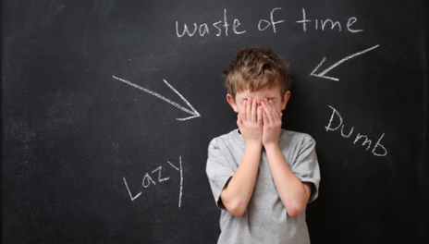
Definition of Exclusion
Notes:
DEFINITION OF EXCLUSION- Don’t talk about what the child is, but we talk about what he is not.
For too many teachers, LD has meant “Lazy & Dumb”
Take away: Mentally disabled, Emotional disturbed, Do not have the opportunity, Modality deficit- hearing, sight, Remains- child with a Learning Disability
• 15-20% or 1 in 5-7 of the U.S. population (100,000’s of students and affected families)

Slide 9
Learning Disability Defined
Neurological Disorder
Imperfect Ability
Criteria- Severe Discrepancy
Areas
Notes:
(1) “a disorder in one or more basic psychological processes involved in understanding or in using language, spoken or written, (2) that may manifest itself in an imperfect ability to listen, think, speak, read, write, spell or, to do mathematical calculations. (3) Including conditions such as perceptual disabilities, brain injury, minimal brain dysfunction, dyslexia, and developmental aphasia. (4) The criteria for determining the existence of a specific learning disability is if the child does not achieve commensurate with her or his age or ability in one or more of the areas listed and the child is provided with learning experiences appropriate for the child’s age and ability levels; and (5) the child has a severe discrepancy between achievement and intellectual ability in one or more of the following areas: oral expression, listening comprehension, written expression, basic reading skill, reading comprehension, mathematical calculation, and mathematical reasoning.” (U.S. Department of Education, 2007)
Neurological Disorder- Difference in the way a person’s brain is wired; Lifelong Issue- can't be cured or fixed
Imperfect Ability
Criteria- Severe Discrepancy Between Achievement and Intellectual Ability
Areas:

Slide 10


Learning Discrepancies
ABILITY
ACHIEVEMENT
oral expression, listening comprehension, written expression, basic reading skill, reading comprehension, mathematical calculation, and mathematical reasoning

Slide 11

Input & Output understanding language or in using it (spoken or written)
imperfect ability to listen, think, speak, read, write, spell
Notes:
Input- how knowledge and information is received, processed, and learned.
Output- how learned knowledge is communicated.
Barrier preventing knowledge coming in or going out, or both.
NOT ALL GREAT MINDS THINK ALIKE- As smart or smarter than their peers. Able to Learn and Succeed in Life- with the right support and intervention.

Slide 12
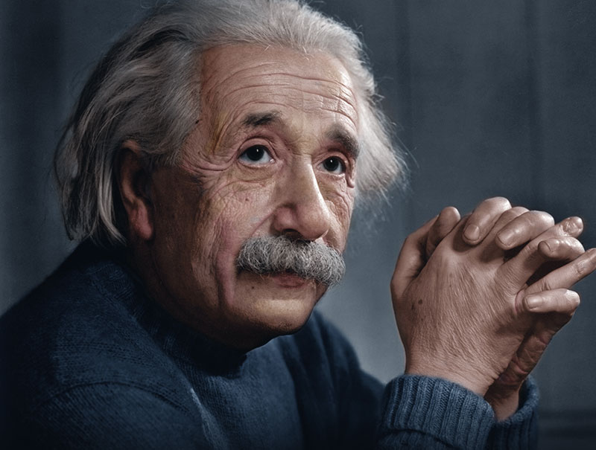
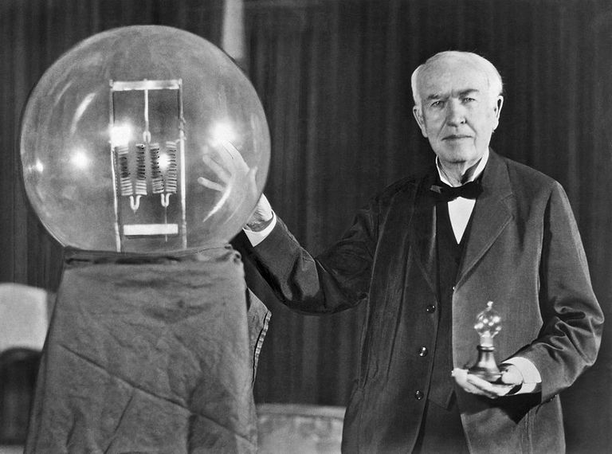
Not All Great Minds Think Alike
ALBERT EINSTEIN
THOMAS EDISON

Slide 13
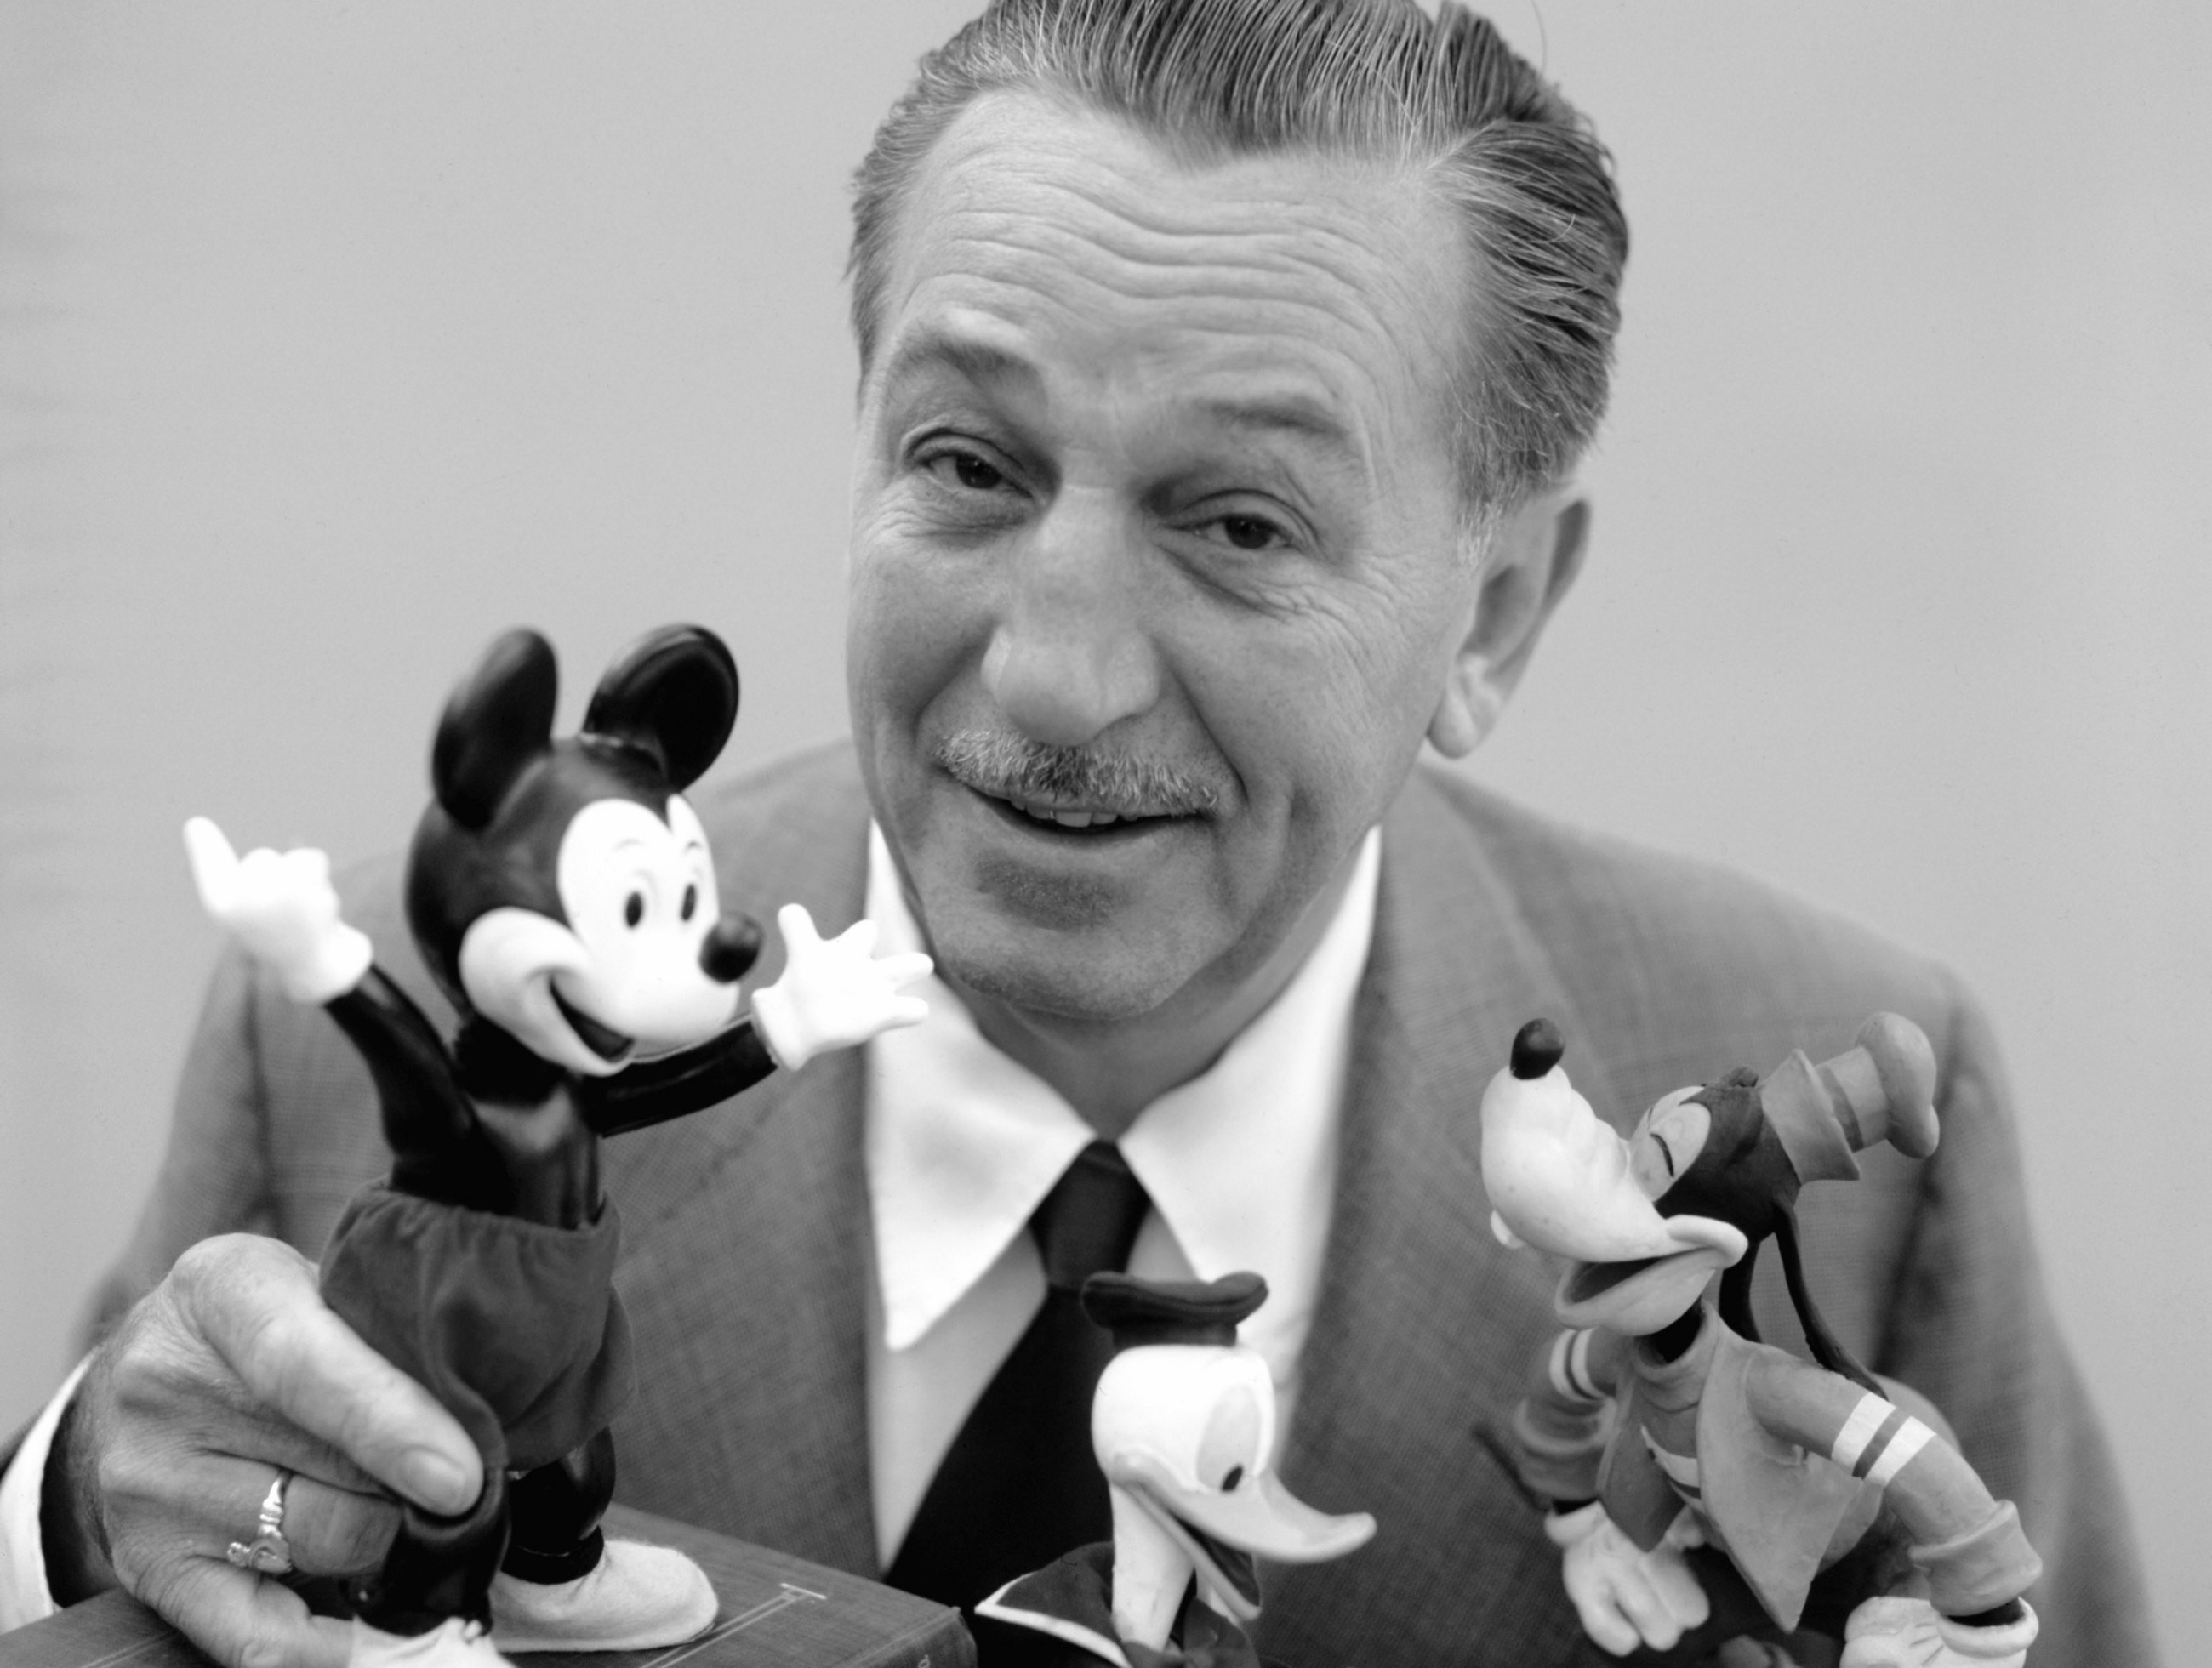

Not All Great Minds Think Alike
WALT DISNEY
RICHARD BRANSON

Slide 14

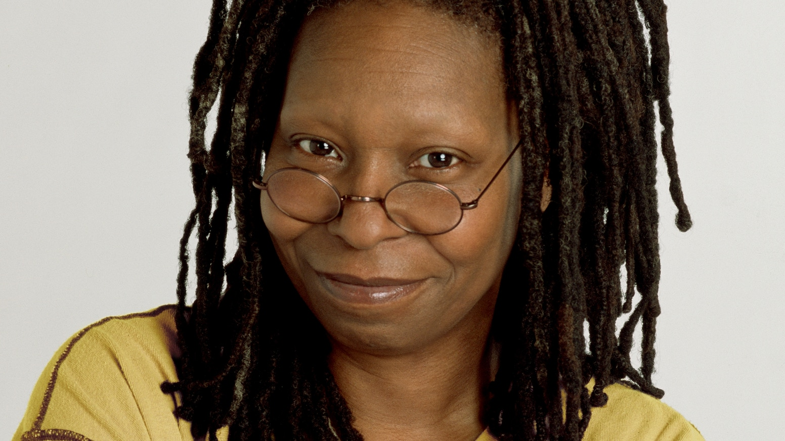
Not All Great Minds Think Alike
JOHN LENNON
WHOOPI GOLDBERG

Slide 15
The STUDENTS
Five students finding their voice and attempting to help their teacher understand
Notes:
FINDING THEIR VOICE- This is about five students finding their voice and attempting to help their teacher understand them so that he could become a better teacher. The credit goes to the five students for their courage and transparency. Their hope is that their voices will be heard and that teachers will change the way they treat and teach students like them.

Slide 16

Kurt
Average – Above Average Intelligence
Superior Perceptual Reasoning
Slow Processing Speed and Memory
Reading Fluency
Failing Academically
Behavior
Notes:
Epitomized what this study is all about- my motivation, failures, hopes, and purpose. Demonstrated several contrasting behaviors simultaneously
Average – Above Average Intelligence
Superior skills for perceptual reasoning (Perceptual Reasoning is the ability to use information gained through the senses and to make sense of them quickly. It is the ability to 'see' what is being asked, to understand and to understand and respond, and to organize information in one’s head through images.
In-depth reasoning- surprisingly well analyzed, creative and connected to a real-life experiences.
Failing Academically
Reading fluency rate- 70 words correctly read per minute (comprehension and decoding issues).
Classroom Behavior- Aggravating; Learning task- simple to complex, he usually cannot complete it or respond with any real clarity. This is usually accompanied by an off-task behavior that is diversionary, distracting, and amusing. These behaviors regularly land him in trouble with his other teachers; teachers frequently describe him as lazy.
Low average processing speed and working memory.

Slide 17
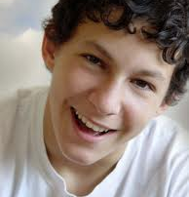
Billy Bob
Average Intelligence
High Average Perceptional Reasoning
Difficulties defining words or identifying similarities between objects or ideas
Social Leader
Parents
Notes:
Lots of potential; easy-going temperament; sense of humor.
Average – High Average Intelligence; Perceptional Reasoning- high average range, demonstrated skill in reproducing geometric designs; Processing Speed- average.
Verbal Comprehension Scale- low average, difficulties defining individual words or identifying similarities between objects or ideas.
Leader- outgoing, always surrounded by friends; Hands are always busy- called him the “Little Drummer Boy.”
Parents- father is illiterate; he cannot read or write; mother- “smart in school” but had to drop out when she “got pregnant,” seizures.

Slide 18

Snowman
Average Intelligence
High Average Verbal Comprehensive and Memory
Reading Struggles
Hard Worker, Popular
Student with Autism
Notes:
Average Intelligence- Verbal comprehension and working memory real strengths high average range.
Academic Struggles- reading, words in isolation and phonetic decoding skills.

Slide 19

Madison
Low Average – Average Intelligence
Processing Speed, Reading
Hard Worker, Detailed
Homework
Notes:
Very outgoing, always surrounded by friends and having a good time.
Low Average – Average Intelligence- very slow processing speed, strength- verbal skills
Struggles with reading decoding but comprehension was better developed.

Slide 20

Cloe
Low Average – Average Intelligence
Working Memory and Processing Speed
Ridiculed by Teachers
Reserved
Notes:
Joy to teach
Other teachers have called her lazy or too dependent on her accommodations and modifications.
Low Average – Average Intelligence- Verbal expression and comprehension skills- strength.
Struggles- working memory and processing speed; reading comprehension and written expression.

Slide 21
What The STUDENTS Want Us to Know
Students Teach Their Teacher

Slide 22

Data Collection Procedures
Specialized Reading Program
Weekly Group Sessions
Structured Interview
Unstructured Interview
Informal Observations
Parent Interviews
Student Records
Learning Style Questionnaire
Video Viewing
Creative Expression

Slide 23


1. We Want to Be Accepted
“I want to be just like them, an individual.”
“We get laughed at. I feel out of place, not normal.”
“I’m just like everyone else but it takes longer to prove stuff.”
“I’m not like everyone else. Sometimes I need time, if not it effects my grades.”
Notes:
Question- What do you wish others knew about you?
Point- this was their reaction to exclusion. Students with disabilities feel different from their peers, and they don’t like being excluded.

Slide 24
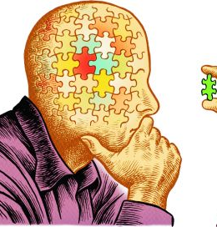
2. We Want to Learn
“I want and need help. I’m not lazy; I don’t know how.”
“I’m not perfect. . . . They want me to be perfect.”
Notes:
Question- What do you wish teachers knew about you?
Point- students with disabilities perceived that their teachers didn’t think that they were interested in learning, when the exact opposite was true.

Slide 25

3. We Want You to Teach Us
“Teach me!”
“Give me instruction.”
Notes:
Question- What do you wish teachers knew about you?
Point- this was a cry for help; they recognized that they needed help in a variety of ways to succeed.
Articulated four areas

Slide 26

3. We Want You to Teach Us
Degree of Difficulty
“We’re always wrong.”
“We have no opportunity. It’s hard for us.”
“I don’t know it. They just throw it at us and expect us to know it.”
“They make me feel stupid.”
Notes:
Point- they cried out that the degree of difficulty with the instructional content was very difficult to grasp.
Inability to grasp the instructional content also results in some very negative and painful consequences and feelings.
Recognized that certain instructional supports helped them succeed.

Slide 27
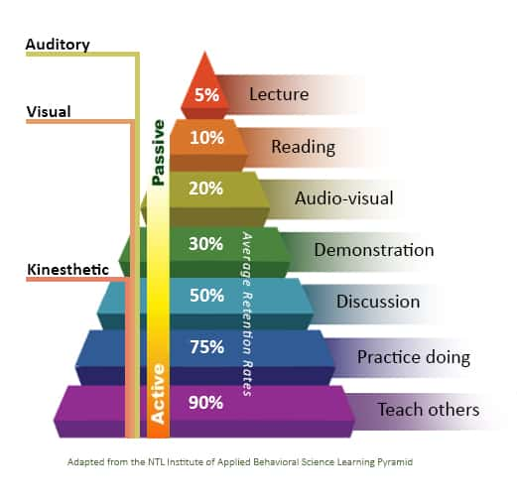
3. We Want You to Teach Us
Diversify the Instruction
“Draw it out.”
Draw pictures, charts, or diagrams; take notes; repeat it out loud, read a textbook
Explain it in different words
Watch videos
Choose projects instead of tests
Notes:
Point- students with disabilities recognized that they learn differently and demonstrate their knowledge differently from other students. They wanted and needed multiple instructional methodologies and alternative assessments.

Slide 28
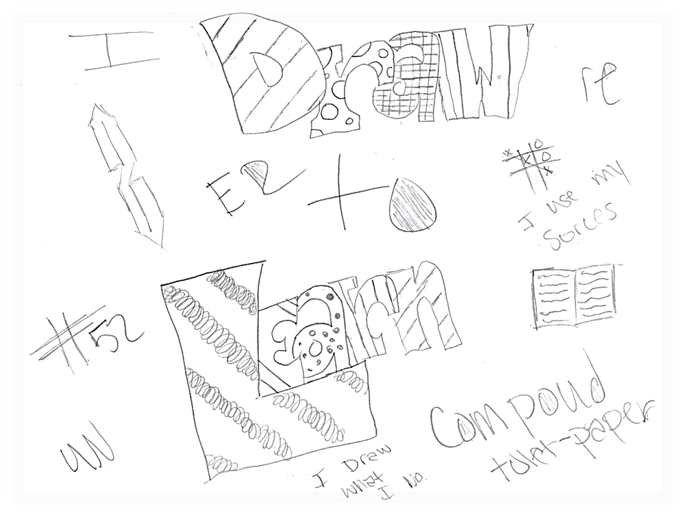
BILLY BOB’S DRAWING
Notes:
What it’s like living with a learning disability?)

Slide 29
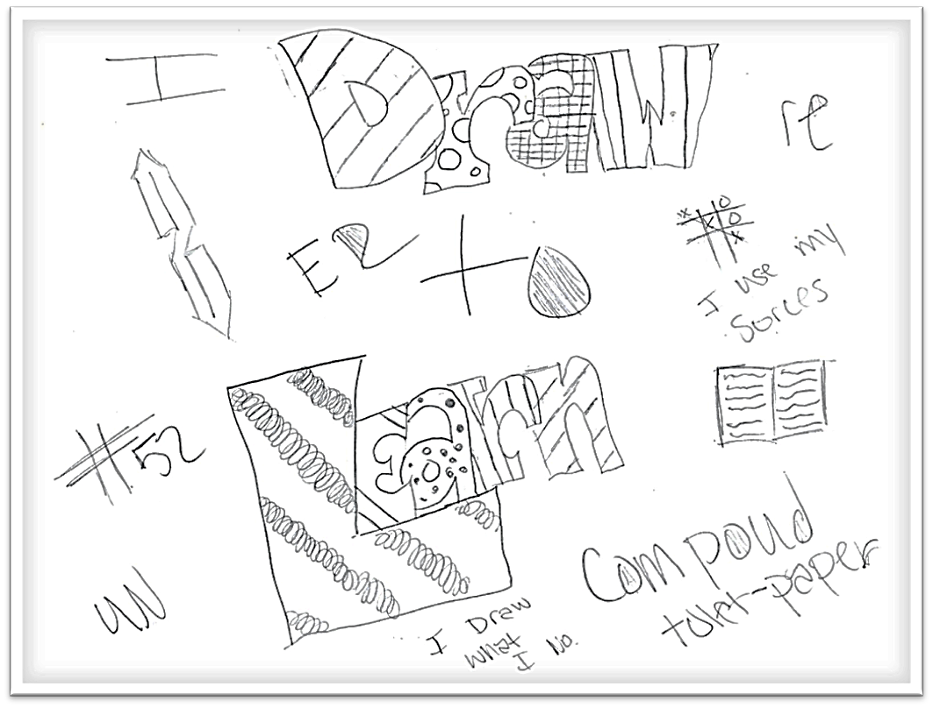
BILLY BOB’S DRAWING
“When I draw, I comprehend, I get it.”
“I don’t get the stuff in my head.”
“Things around the room, I get what I need to know (reinforces learning).”
Notes:
“I draw what I know; I use my sources.”
“When I draw, I comprehend, I get it.” “I don’t get the stuff in his head” but “the things around the room I get what I need to know.
”Billy Bob was referring to posters and visual aids in the classroom to reinforce learning.
Some markings were not quite clear and he forgot why he wrote [compound toilet paper].

Slide 30
C.I.T.E. Learning Style Inventory
How We Learn
Notes:
Only Consensus- Tactile-Kinesthetic- All of them learn best by using their body and sense of touch to learn about the world around them. A combination of stimuli experience and self-involvement is needed. The manipulation of material along with the accompanying sights and sounds (words and numbers seen and spoken) makes a big difference.
They may not be able to understand or keep their mind on their work unless they are totally involved. They naturally seek to handle, touch and work with what is being learned.
Auditory-Language/Numerical- Kurt and Billy Bob learn from hearing words or numbers spoken. Benefit from hearing audio tapes, rote oral practice, lecture or a class discussion.
numbers with groups of two or more is important.
Visual Language/Numerical- Snowman, Madison, and Cloe learn well from seeing words in books, on the chalkboard, charts or workbooks. All important data should be given on paper. They need a variety of written materials and time to study it.
✓ They need to write down words that are given orally in order to learn by seeing them on paper.

Slide 31
C.I.T.E. Learning Style Inventory
How We Demonstrate
Notes:
Expressiveness-Oral- Kurt, Snowman, and Cloe prefer to tell what they know. They should be evaluated more by what they say than what they write.
• Expressive-Written
Expressiveness-Written- Madison can write fluent essays and good answers on tests to show what she knows.

Slide 32

3. We Want You to Teach Us
Demonstrate
“Show me.”
Doing or watching experiments
Make it more fun (to make up for weaknesses)
Not likely to help- “remember what is say.”
Notes:
Question: When you need extra help in a class, what things are most likely to help you?
Point- they recognized that they have a better chance of learning and succeeding with concrete tactile instructional methods.

Slide 33

3. We Want You to Teach Us
Clarity
“You’re not giving clear instructions. Tell us what you want us to do. Break it up.”
Explain at the beginning what we will be doing
Assignments- write on the board; get a list of assignments and due dates, class handouts and worksheets (forget or do not understand the instructions or written directions)
Be able to ask questions- “I have a lot of questions.”
Notes:
Question- When you need extra help in a class, what things are most likely to help you?
Point- students with learning disabilities have difficulty understanding directions or assignments when they are not delivered with clarity and diverse instructional supports.

Slide 34

4. We Need More Time
A short time to do things.
“We will always finish last; we will always be beat.”
More time, “don’t rush me!”
In class, can’t write fast enough to keep up.
Notes:
The Pace Is Too Fast
Point- this is the complaint and cry that they exclaimed most often. The classroom experience moves much too fast for them because students with learning disabilities have great difficulty processing the language. They left no room for misinterpretation; the classroom experience moves too quickly for them participate and comprehend. Normal classroom pace is Formula One for students with LD.
This piece of data appeared so often and with such strong emotion that it must be heard, and they want us to hear them loud and clear.

Slide 35
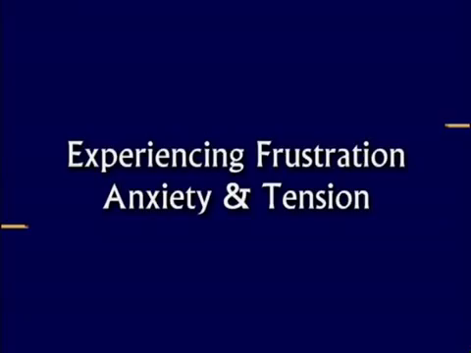
Learning Disabled Simulation

Slide 36
Processing
Notes:
PROCESSING- While the non-learning disabled students are processing their answers to questions, the students with learning disabilities are processing the question.

Slide 37
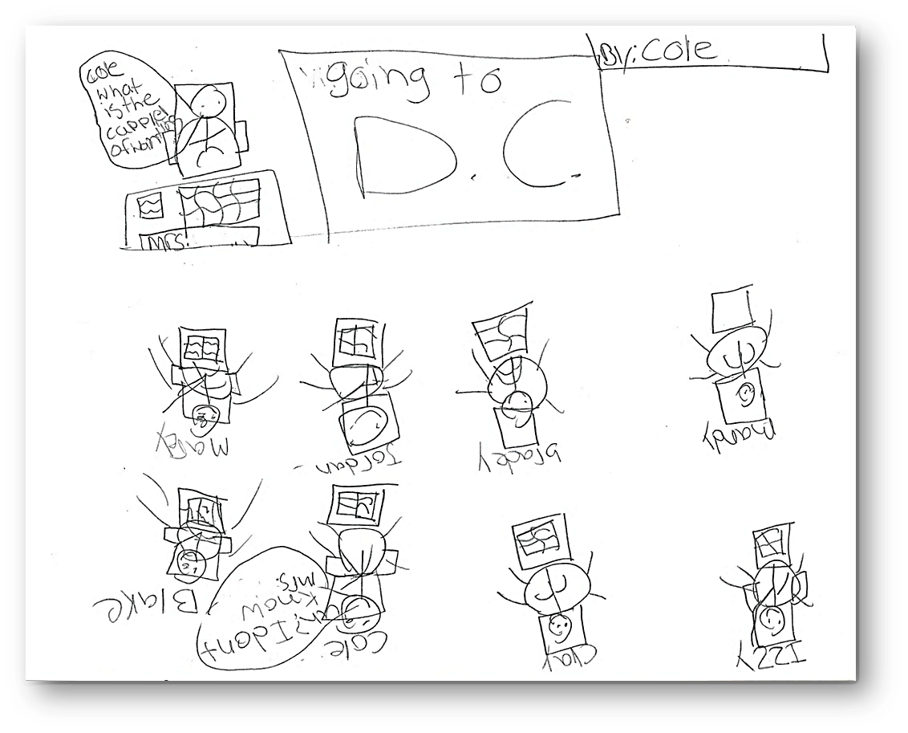
CLOE’S DRAWING
Notes:
Cloe is sitting in the back of the classroom. The teacher asks her, “Cloe, what is the capital of our nation?” In the front on a white board in big letters are the words, “going to D. C.”
Her response is “I don’t know.” She knows the answer, but she panics, and she is afraid to embarrass herself in front of others.
She just wants to hide because she has been humiliated many times in the past when she panics or doesn’t know the answer.
Processing the Question- what (not who or when), capital (is it a city, state, country), country (what country?)—I don’t know.—laughter.
Questioning can create fear and anxiety. We need to minimize it.
They often don’t hear or understand the question when it is presented the first time, especially if a question has multiple parts.
“Time is a gift to the child with a learning disability,”

Slide 38

5. We Can’t Concentrate
“I can’t focus on anything very long. I daydream all the time. I’m easily bored.”
“Things come clear at the beginning, until you get in to them, then you get lost and sidetracked.”
Notes:
Point- students with learning disabilities are easily distracted.
Distractibility- the problem is not that they can’t focus; the problem is that they focus on everything.

Slide 39

6. We Get in A Lot of Trouble
Problems
Perceptions
Notes:
Point- it is common for students with learning disabilities to get in a lot trouble.
Problems- students act out as a way out to escape the humiliation of not feeling adequate.
Perception- whether one can agree with the accuracy of their statements, one cannot argue that their perceptions are very real and painful. It has left a profound mark on their effort and self-image.

Slide 40

7. We Are Hurting
“We get laughed at. I feel out of place, not normal.”
Everyone laughs at me.
“Stop yelling at us!”
Talking when everyone else is (he’s referring to getting into trouble, he feels singled out).
Notes:
“The most curious offspring of shame is shyness.”

Slide 41
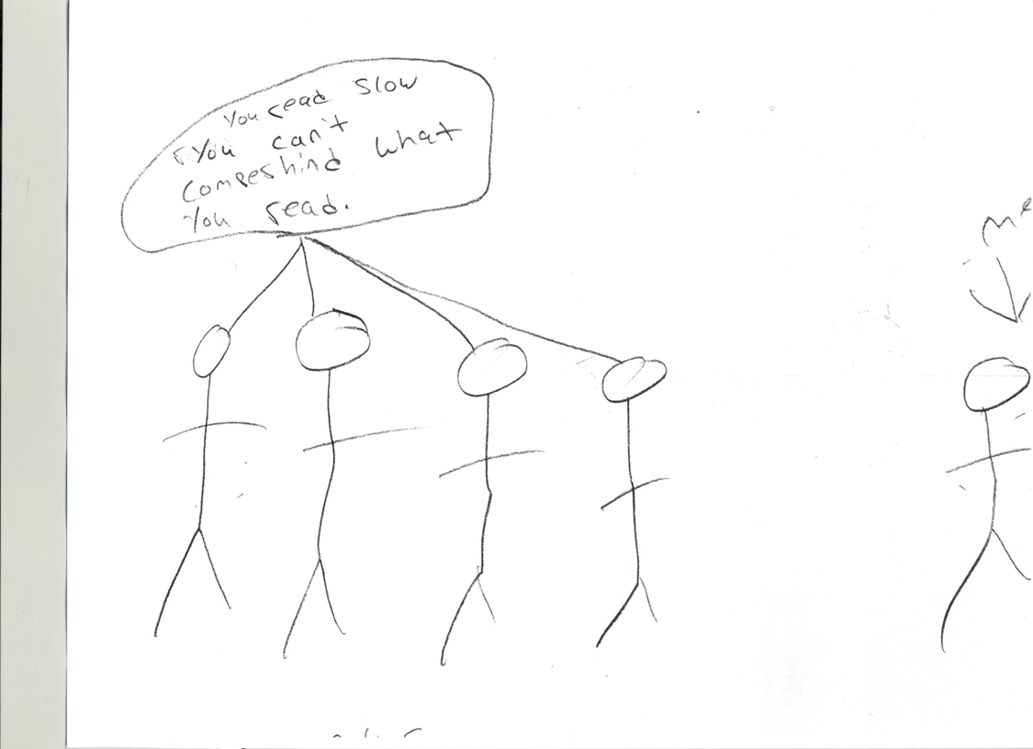
SNOWMAN’S DRAWING

Slide 42
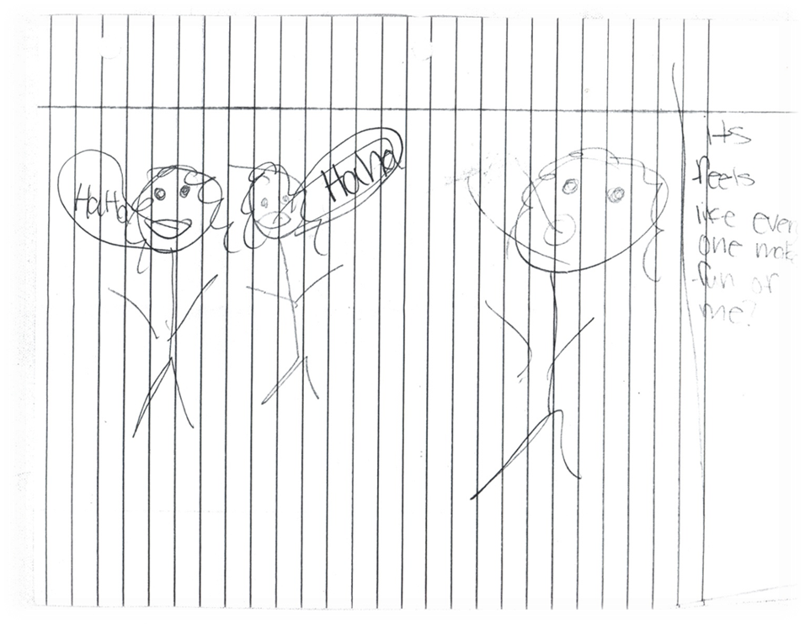
MADISON’S DRAWING

Slide 43

8. We Are Close to Giving Up
“I feel if I would fail, I would drop out . . . .”
“I’m embarrassed because . . . .”
Notes:
Point- the cumulative affects of failure have taken a toll and there is a pervasive feeling that failure is their destiny.

Slide 44
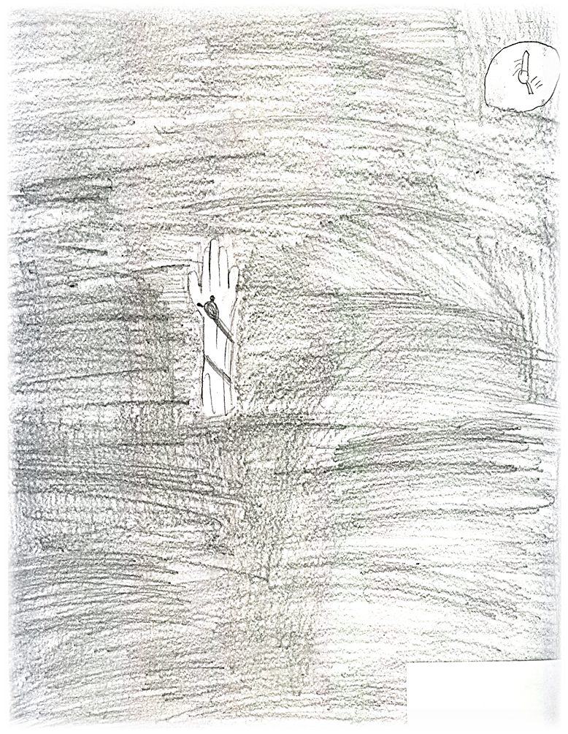
KURT’S DRAWING
Notes:
What it’s like living with a learning disability?
“Darkness is all around;
a hand is raised.
Darkness is pulling down the hand as time goes on.
There is a clock.
It symbolizes the school year starting with my hand
because I was smart.
I don’t raise my hand as much
other hands go up before mine
it takes me time to think about it
What I’m trying to say is
I’m not that smart as time goes on.
I was held back in first grade
behavior
it hurts now.
I feel if I would fail, I would drop out
my sister would be in a higher grade.
I’m embarrassed because I got a blue ribbon in a 4H speech and instead of a purple, like her.
Darkness—the stuff I can’t get right.
Arm (what I know).
In writing class,
she speeds through it
not enough time to get it
too fast.
I get into trouble.
Teacher calls me lazy.
Not enough time.”
Father & brother

Slide 45
KURT’S DRAWING
“Darkness is all around;
a hand is raised.
Darkness is pulling down the hand as time goes on.
There is a clock.
It symbolizes the school year starting with my hand
because I was smart.
I don’t raise my hand as much
other hands go up before mine
it takes me time to think about it
What I’m trying to say is
I’m not that smart as time goes on.
I was held back in first grade
behavior
it hurts now.
I feel if I would fail I would drop out
my sister would be in a higher grade.
I’m embarrassed because I got a blue ribbon in a 4H speech and instead of a purple, like her.
Darkness—
the stuff I can’t get right.
Arm (what I know).
In writing class,
she speeds through it
not enough time to get it
too fast.
I get into trouble.
Teacher calls me lazy.
Not enough time.”

Slide 46
How to Teach Students with Learning Disabilities
Students Teach Their Teacher

Slide 47

Language Acquisition Challenges
Complex Cognitive Processes:
Attention
Auditory and visual perception and processing
Memory
Executive function
Notes:
Executive function- "command and control" function; help you manage life tasks of all types; disorganization.

Slide 48
Language Acquisition Challenges
Development of four interdependent systems:
Pragmatic
Phonological
Semantic
Grammatical
Notes:
Pragmatic (communicative use of language in a social context)
Phonological (perception and production of sounds to form words),
Semantic (processing of meaning),
Grammatical (use of syntactic and morphological rules to combine words into meaningful sentences).

Slide 49
Input & Output understanding language or in using it (spoken or written)
imperfect ability to listen, think, speak, read, write, spell
Notes:
Research- The learning disability had to be addressed in educational measures taken. Once the LD issues were addressed, the students could learn

Slide 50
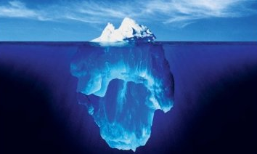
1. Build a Social-Emotional Connection
    Safe
    Empathetic
    Confidence
Notes:
Science has conclusively proven that a student’s emotional state impacts how they learn. Emotions directly influence our brain functions. The brain responds differently to different emotions. When a student experiences positive emotions the student learns well.
“Students may never remember what you taught them, but they will never forget how you made them feel.”

Slide 51

2. Create a Supportive Network
  Family
  Professionals
  Colleagues
  Peers

Slide 52

3. Become Informed
  Diagnosis
  Interventions

Slide 53

4. Become an Advocate
Voice

Slide 54

5. Experiment
  Dynamic
  Human
  Imperfect

Slide 55

6. Differentiated Instruction
  Respond to variance among learners in the classroom
  Content
  Process
  Product
  Learning Environment
Notes:
Differentiated Instruction- misunderstandings
Differentiation consists of the efforts of teachers to respond to variance among learners in the classroom. Whenever a teacher reaches out to an individual or small group to vary his or her teaching in order to create the best learning experience possible, that teacher is differentiating instruction.
Based upon the observations and research that students learn through a variety of instructional practices.
Delivers what a student needs through multiple methodologies.
Content- what the student needs to learn or how the student will get access to the information
Process- activities the student engages in order to learn or master the content. I deliver instructional content in multiple ways and I adjust according to my knowledge of a student’s strengths.
Products- culminating assessments that what the student has learned; assess in multiple ways according to the student’s strengths
Learning environment– the way the classroom works and feels.

Slide 56
Vocabulary Squares

Slide 57
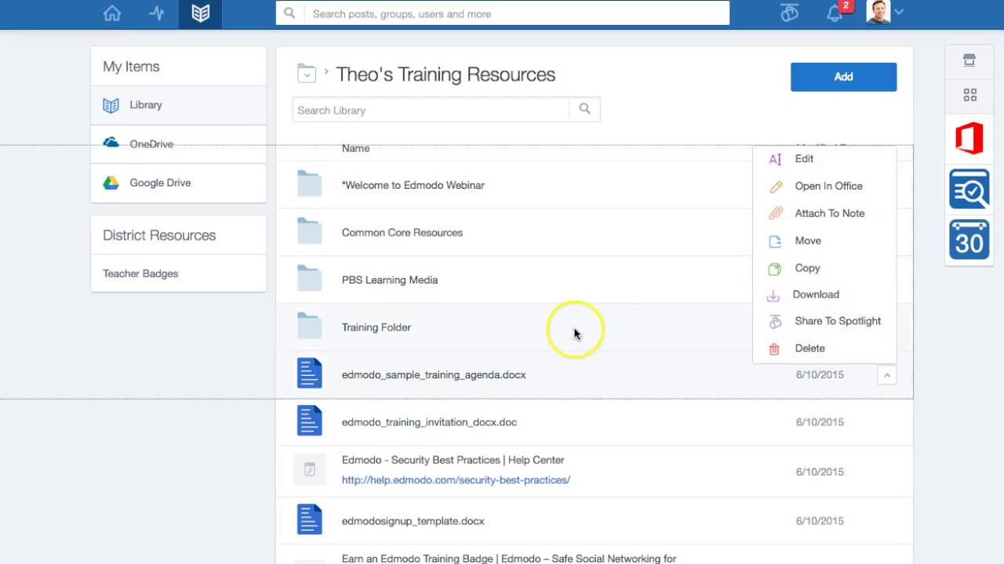
Private Website

Slide 58

Groupings
Variety
Inclusive
Specialized Needs

Slide 59

7. Formative Assessments
  Process of ongoing feedback used by teachers to improve instruction and students to improve learning
Notes:
A process used by teachers and students during instruction that provides feedback to adjust ongoing teaching and learning to improve students' achievement of intended instructional outcomes.
Ongoing Feedback Used By: Teachers to improve instruction, Students to improve learning
Concepts- students are struggling to understand
Skills- students are having difficulty acquiring
Learning standards- not yet achieved
Adjustments can be made to lessons, instructional techniques, and academic support

Slide 60
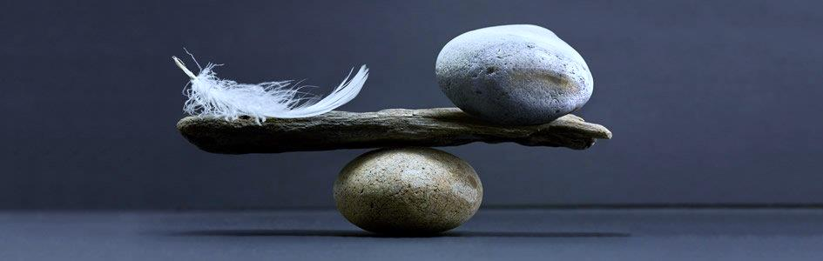
7. Formative Assessments
Intentional Questioning Strategies
“You can tell whether a man is clever by his answers.
You can tell whether a man is wise by his questions.”
—Naguib Mahfouz, winner of the 1988 Nobel Prize for Literature

Slide 61


Slide 62
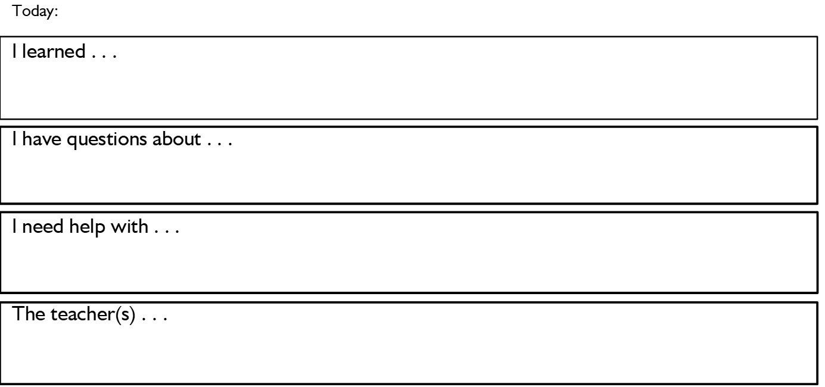
Charts and Diagrams
Daily Exit Slip
Venn Diagram
a
c
b

Slide 63

8. Time and Organizational Management
  Processing
  Agendas
  Apps
Notes:
Questioning Strategies- Richard Lavoie’s- stand in front; Verbal Cues; Repeat Multiple Ways

Slide 64

9. Accommodations and Modifications
Accommodations
Changes how a student learns the material
Changes to instruction or curriculum that alters either the content of that instruction or student performance expectations
Modifications
Changes what a student is taught or expected to learn
Changes in instructional delivery, testing procedures, or materials that allows a student to access the information and to accurately demonstrate knowledge.
Notes:
Accommodation Examples: a student with dyslexia might listen to an audio version of a book. But it’s still the same book that the rest of the class is reading; using spell-check might help a student with writing difficulties to take notes during class; extra time to complete a test or using a keyboard if the physical act of writing is difficult.
Modification Examples- a student could be assigned shorter or easier reading assignments, or homework that’s different from the rest of the class; test may require the class to study 20 words. However, a student with modifications might only have to study 10.

Slide 65

Scripting
“Treat a man as he is and he will remain as he is. Treat a man as he can and should be and he will become as he can and should be.” (Goethe)

Slide 66
THANK YOU
Michael VanHook, M. Ed.
MSV Educational Network
www.msveducationalnetwork.com
michaelsvanhook@gmail.com
55-43-98801-9416

